Slide 1


Next Up:
Justin Grote

Slide 2
3
3

Slide 3
2

Slide 4

1
JustinGrote

Slide 5
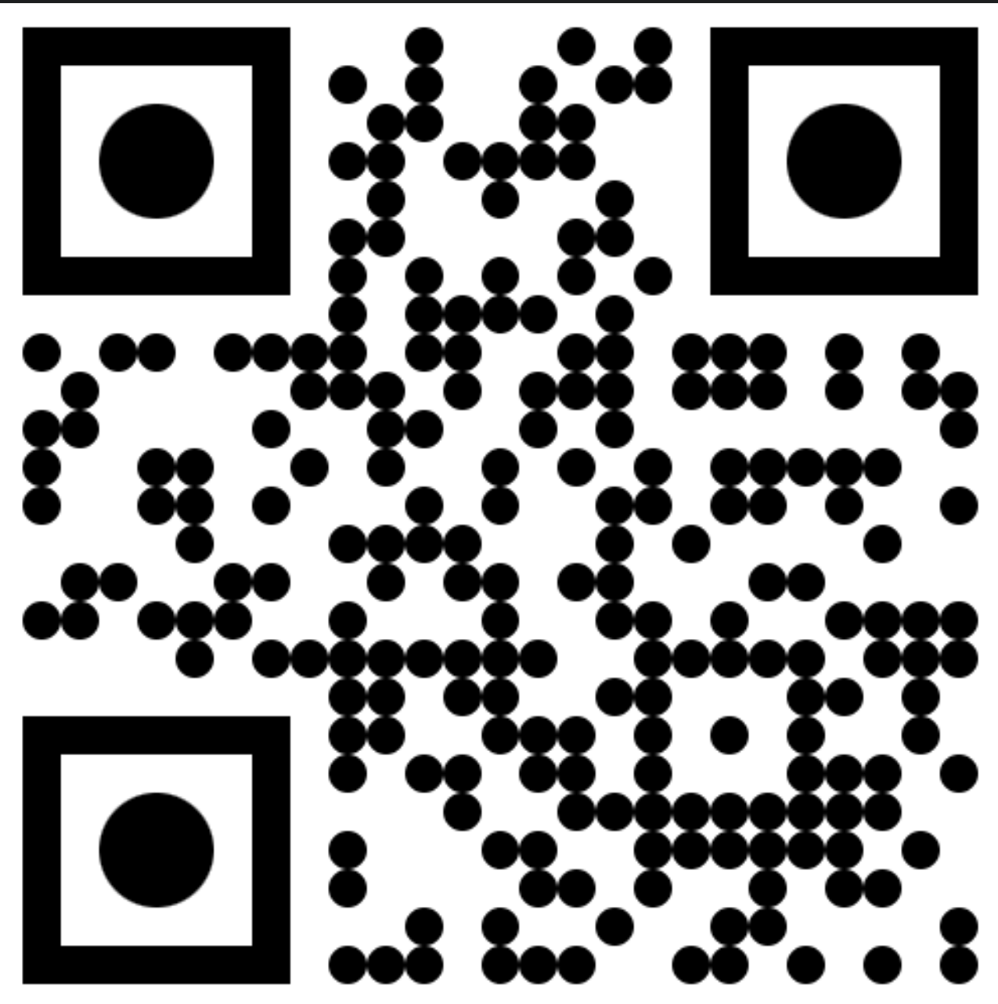
Building Custom GitHub Actions with PowerShell
Justin Grote
Session Content

Slide 6

Many thanks to our sponsors:

Slide 7
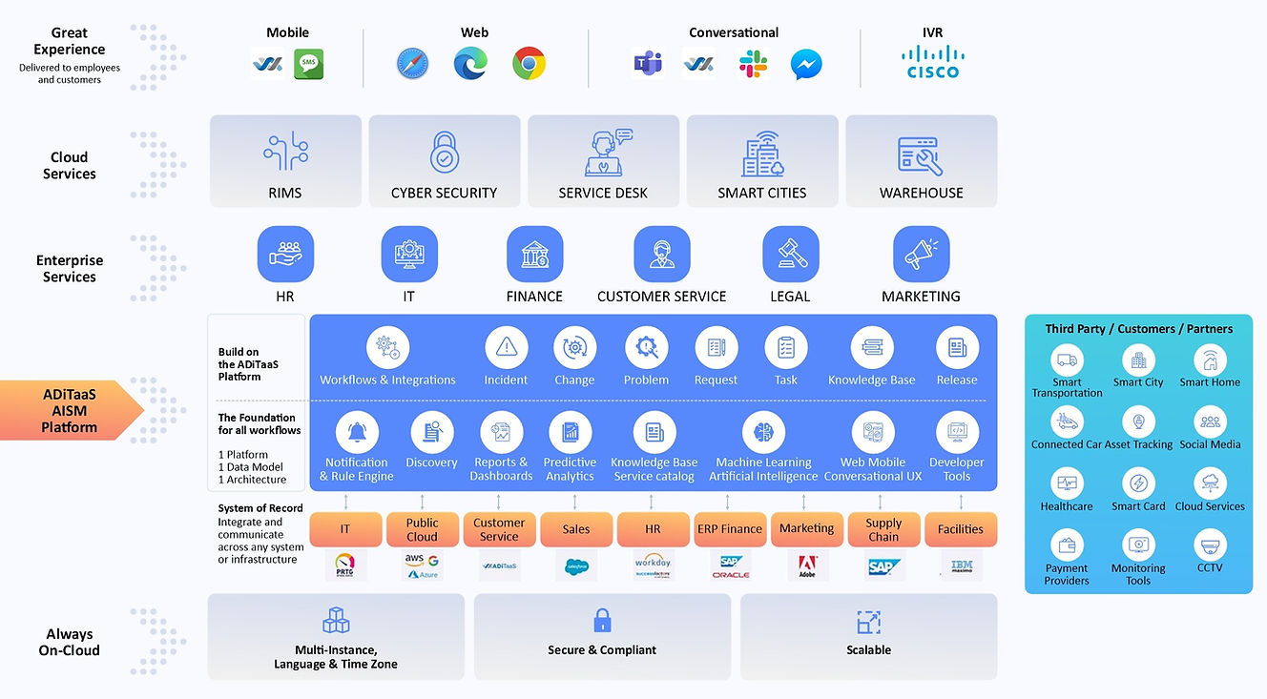

Thank you to Allied Digital!

Slide 8

Justin Grote
Datacenter Solutions Architect – Allied Digital Services LLC
4x Microsoft MVP
PowerShell VSCode, Pester VSCode, PowerHTML, ModuleFast, SecretManagement, PoshNMAP, IPNetwork, Press, etc.
Session Content

Slide 9
Agenda
A little GitHub Actions Background
Getting Setup
Trying out Actions
More Advanced Actions
Break?
Playtime
Anatomy of a Published Action: ModuleFast
Review/Q&A

Slide 10
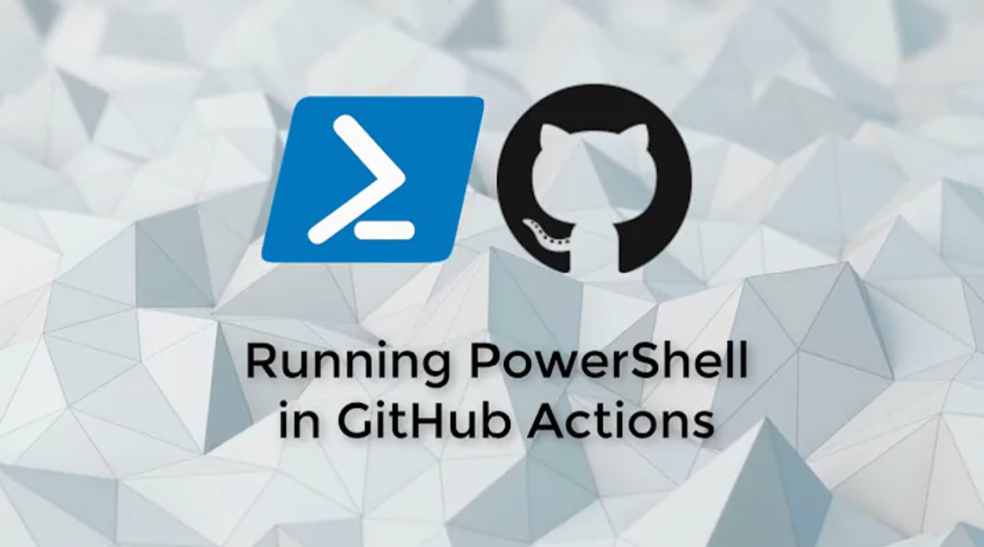
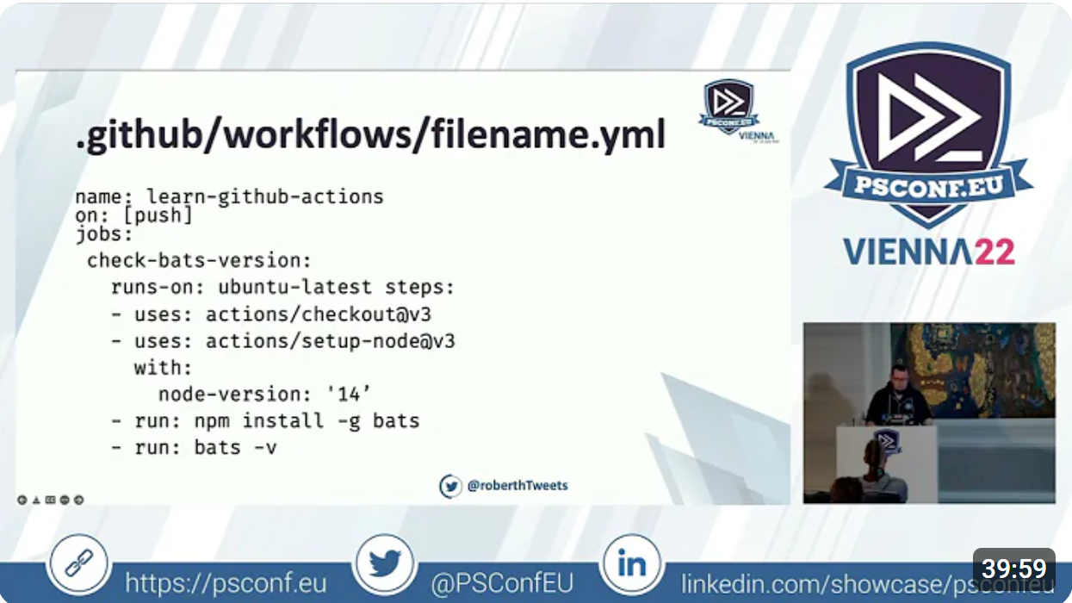
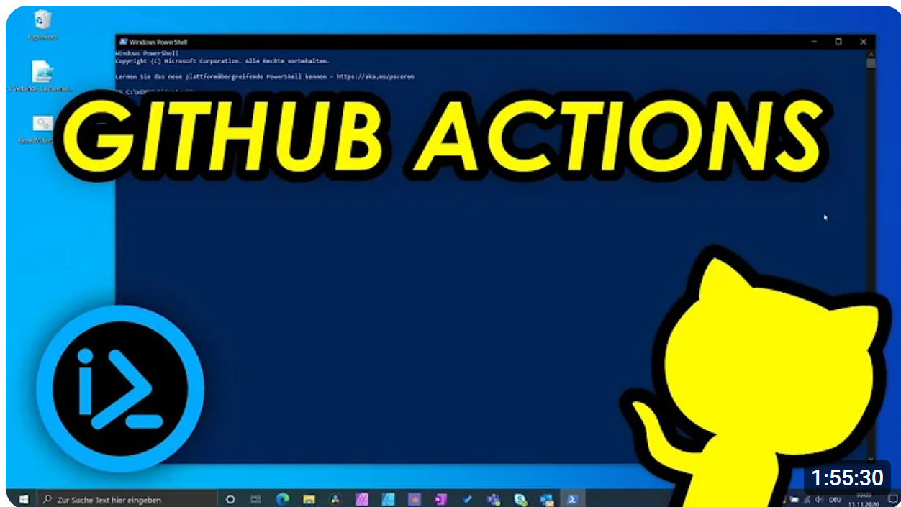
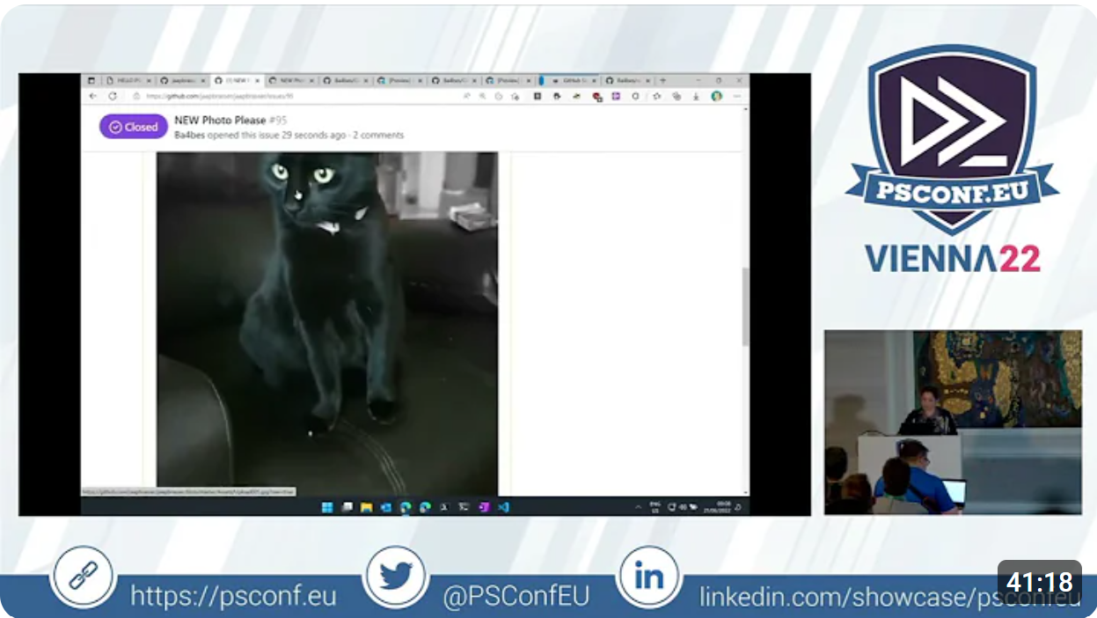
Other Great Presentations
Adam Driscoll
Roberth Strand
Chrissy LeMaire
Barbara Forbes

Slide 11
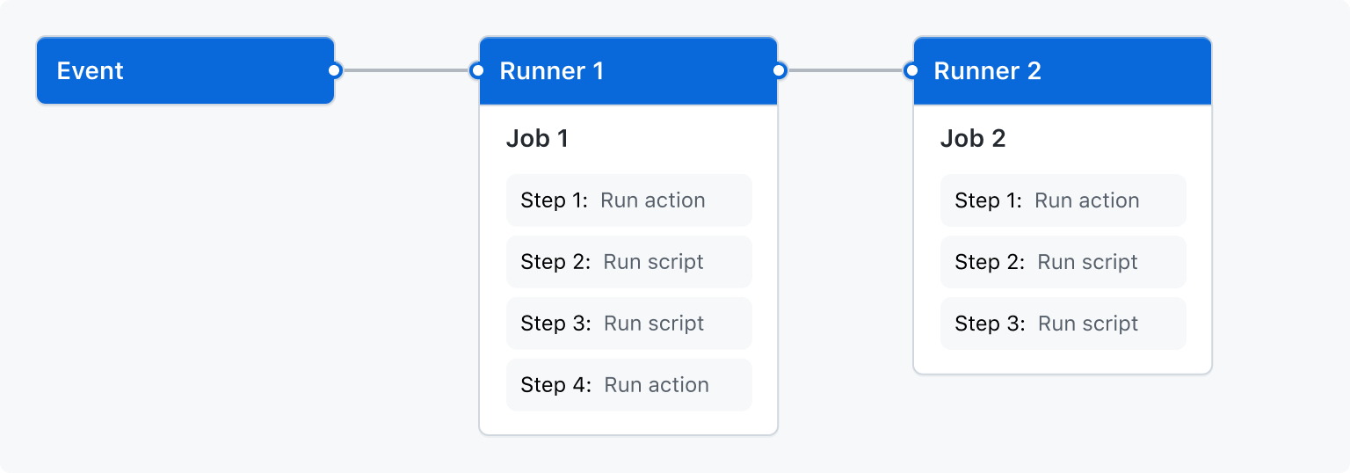
Github Actions Anatomy

Slide 12
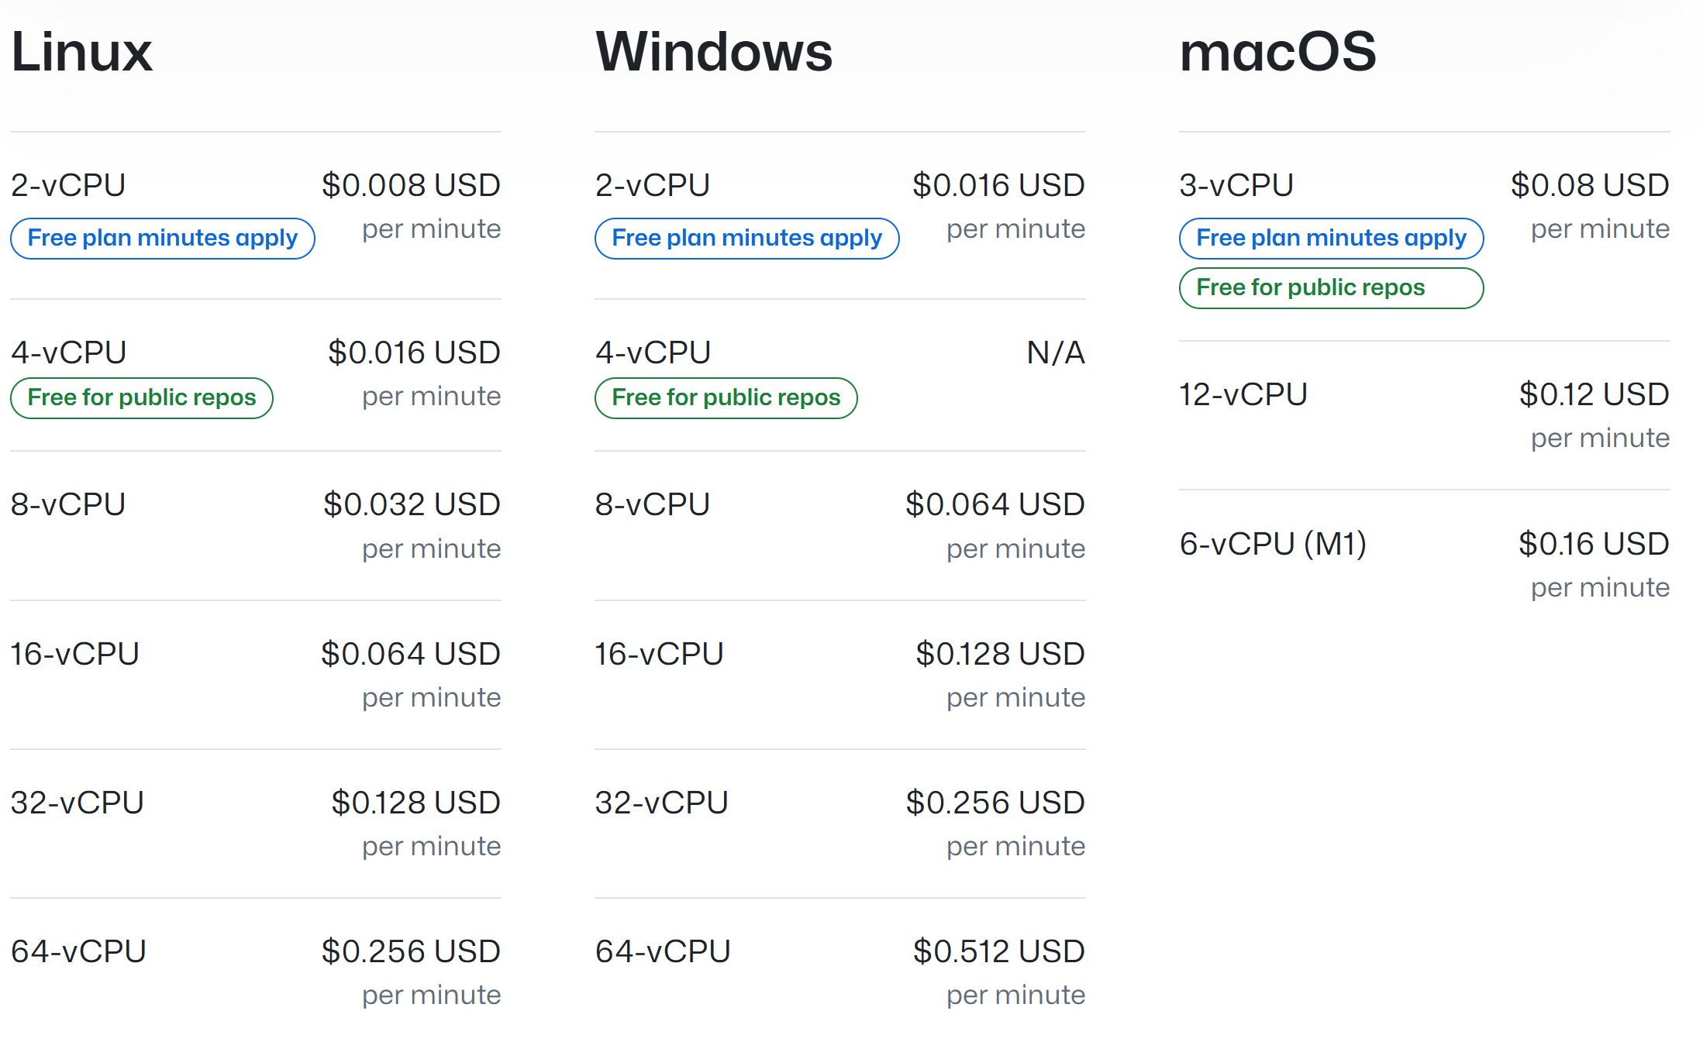
GitHub Actions Pricing

Slide 13

Follow Along Time!

Slide 14
Help Hands!
👋
🙌
I have a question!
Help I’m stuck!

Slide 15
Setup
Sign up for Github!
Fork this repo: https://bit.ly/psgha
Go to Actions -> Enable Actions
Ready!

Slide 16
GitHub Action Local Testers
pester/Pester: Pester is the ubiquitous test and mock framework for PowerShell. (github.com)
nektos/act: Run your GitHub Actions locally 🚀
ChristopherHX/runner.server: An unofficial Local GitHub Actions and Azure Pipelines Emulator

Slide 17
References
GitHub Actions documentation - GitHub Docs
Building and testing PowerShell - GitHub Docs
adamdriscoll/pwsh-github-actions: Examples of using PowerShell in GitHub actions
Configuring private networking for GitHub-hosted runners in your enterprise - GitHub Enterprise Cloud Docs
About security hardening with OpenID Connect - GitHub Docs

Slide 18
Q&A
15 minutes
Session Content

